Slide 1
House Price Prediction Project Report
By Kapil Sourav Rout
Intern KIIT University

Slide 2
Acknowledgement
I express my sincere gratitude to HR,Training and IT department heads for allowing me to carry out summer internship programme.
I also extend my gratitude to my college for giving the chance to join this internship programme at JSL Jajpur.
My sincere thanks goes to Santa Sir,Ayush Sir and Ashok Sir for providing me technical and theoritical support.

Slide 3
Certificate
We hereby certify that Kapil Sourav Rout,KIIT BBSR sucessfully carried out from 05/05/2025 to 30/06/2025 internship work on the title ‘House Sale Prediction’.
We wish him the best of luck for future endeavour.
Training Department

Slide 4
Content
Aim of the project
Introduction
Dealing with Null values
Exploratory Data Analysis
Scaling Features
Training the Model
Conclusion

Slide 5
Aim Of The Project
To create a model that predicts House Sale Price.

Slide 6
Introduction
A house price prediction model is a tool that uses data analysis and machine learning to estimate the likely selling price of a property. It helps buyers, sellers, and investors make informed decisions by providing an accurate valuation based on various factors.¹
Predicts price:
The model takes various characteristics of a house (like size, location, number of bedrooms, etc.) and uses them to predict its market value.²
Informs decisions:
This prediction helps buyers decide what to offer, sellers set a competitive price, and investors identify profitable opportunities.³
I will be creating a model to predict House Sale prices.I will be using Random Forest tree Regressor and support vector regressors and showcase the difference between the two.

Slide 7
Introduction
How it works:
Data collection:
The model is trained on a dataset of past house sales, including information on property features and their corresponding prices.⁴
Machine learning algorithms:
Algorithms like linear regression, decision trees, or neural networks are used to find patterns and relationships between the features and the prices.⁵
Prediction:
Once trained, the model can be used to predict the price of a new house by inputting its characteristics.

Slide 8
Introduction
Why it's useful:
Accuracy:
Machine learning models can often provide more accurate price predictions than traditional methods like relying on an appraiser's gut feeling. ⁶
Efficiency:
They can analyze large datasets and make predictions quickly, saving time and effort.
Transparency:
Some models can also show which features have the biggest impact on price, providing insights into the market.

Slide 9
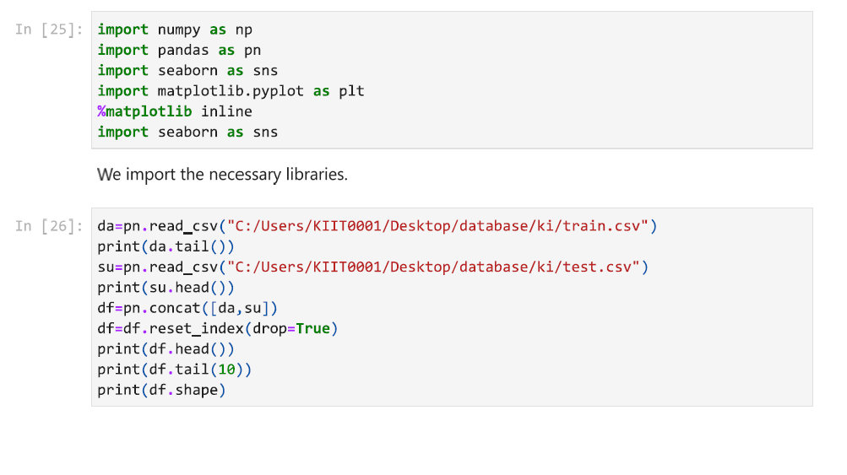
Creating the Model
I will be showcasing the steps and codes taken to train and create our model that predicts house sale price.
We combine the train and test sets for exploratory data analysis.

Slide 10
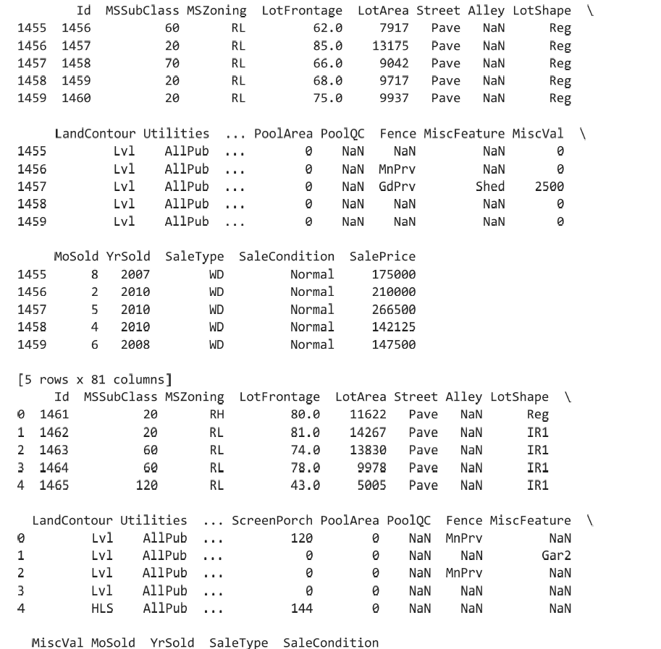
This data shows us the rows of the dataset.We can see that many columns have null values and we have to be careful in dealing with them.

Slide 11
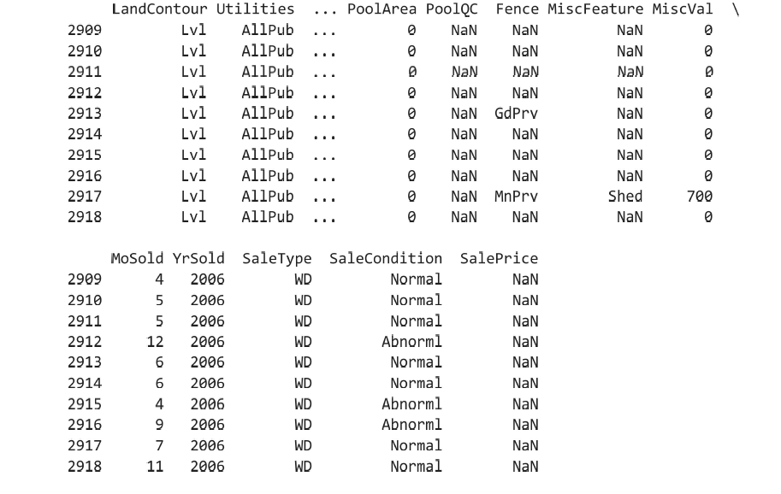
These are the last 10 entries from the test set.We can see that the SalePrice is null in the entries.So we will be using the model to predict the SalePrice of this set and create a new test set from the training set for testing our model.

Slide 12
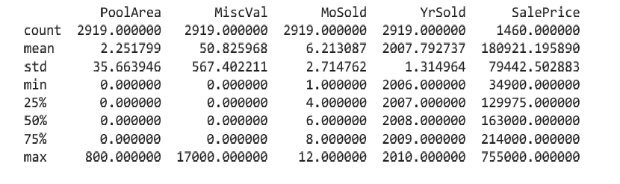
With the describe function,we can see detailed information of the data in the dataset.We can see that the mean,standard deviation, and minimum and maximum values of the data.25%,50%,75% indicate percentile of the data i.e,75% of the Sale Price is below 214000.

Slide 13
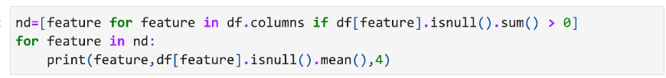
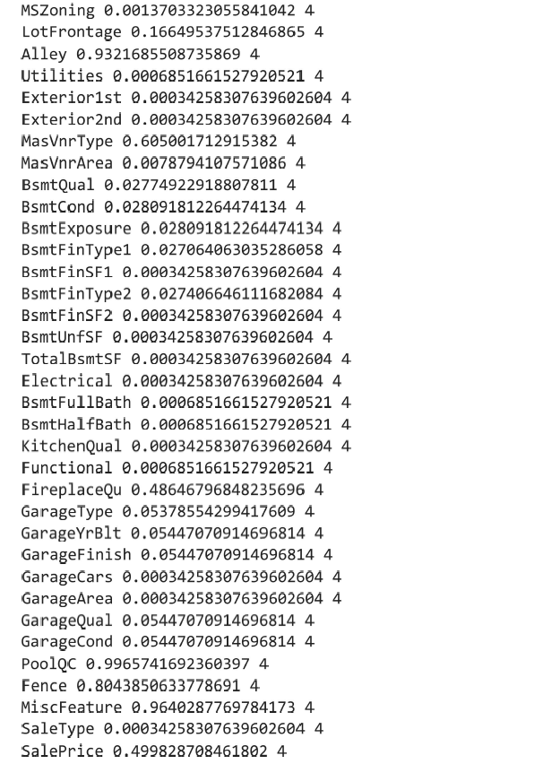
Dealing with Null Values
We can see the percentage of null values in each attribute and we can see that Alley has over 90% as null values,so we must clean that up by replacing them with 'missing' value

Slide 14
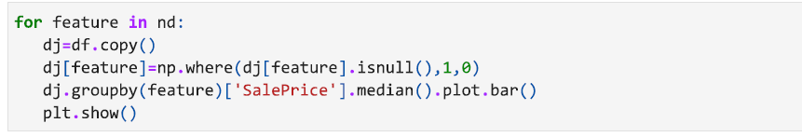
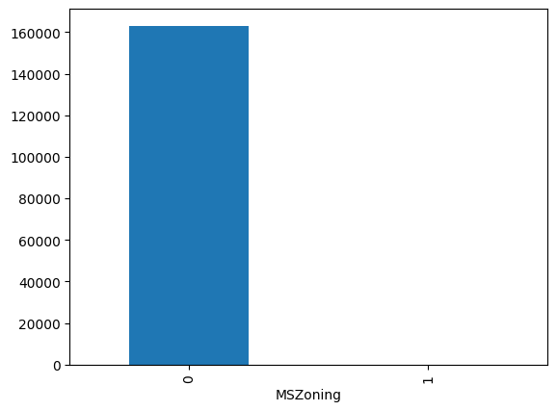
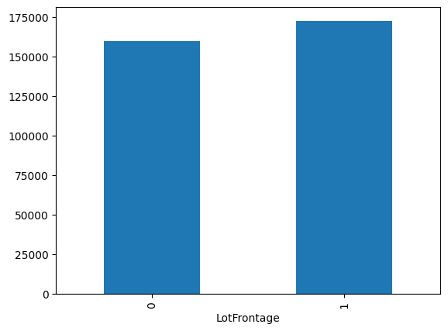
This code will plot bar graphs which shows us the median of Sale Price for non null values and null values where 0 represents non null values and 1 represents null values.

Slide 15
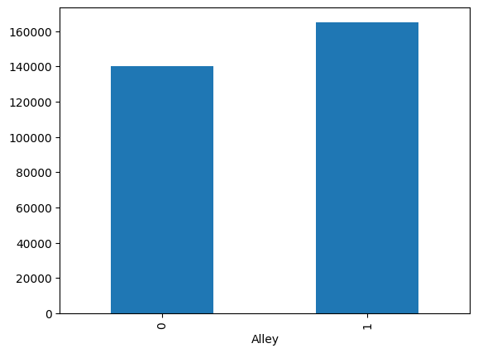




Slide 16
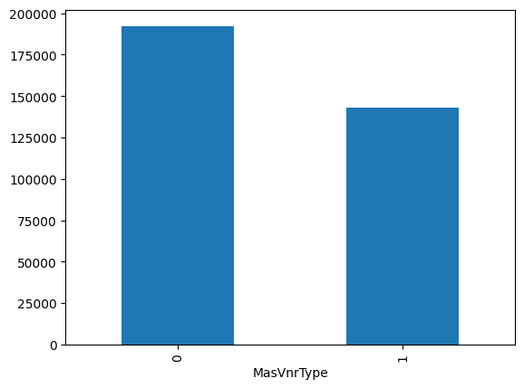
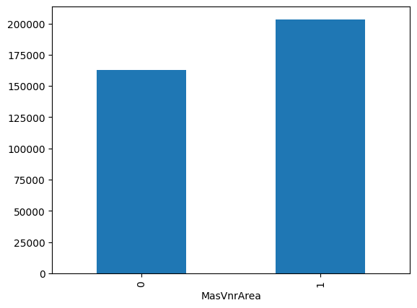
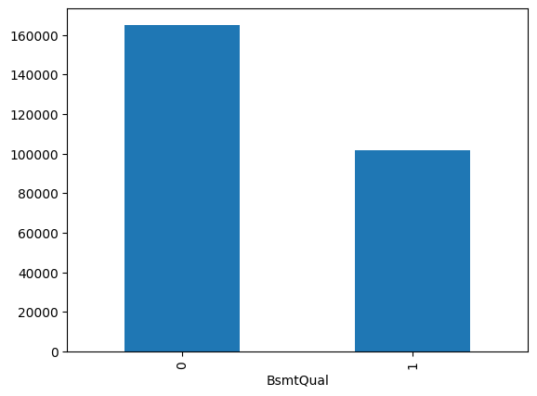


Slide 17
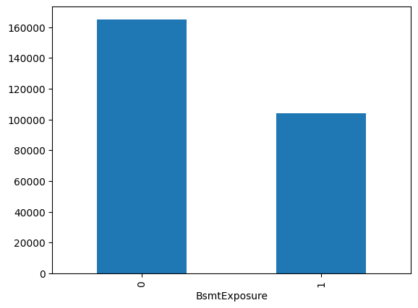




Slide 18


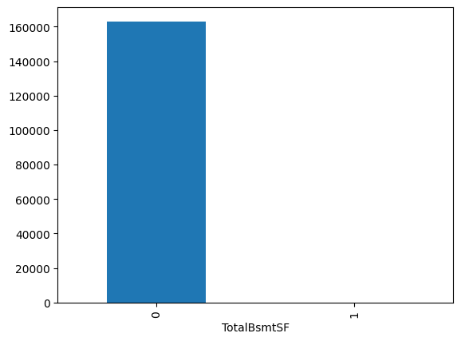
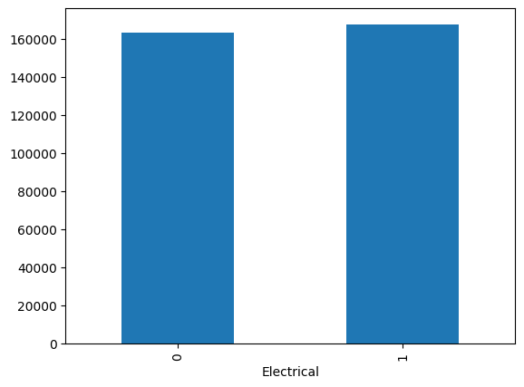

Slide 19
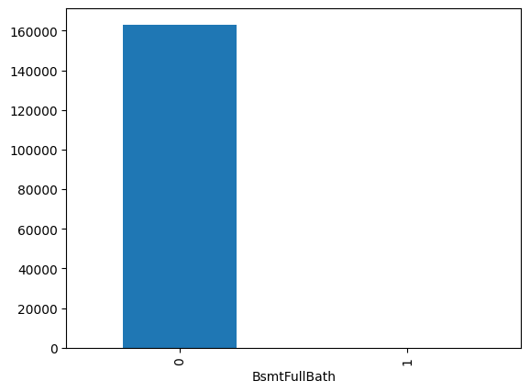




Slide 20
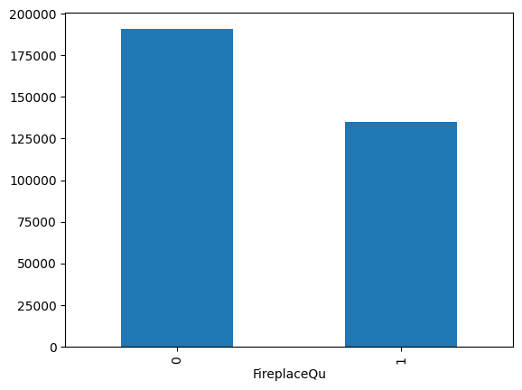
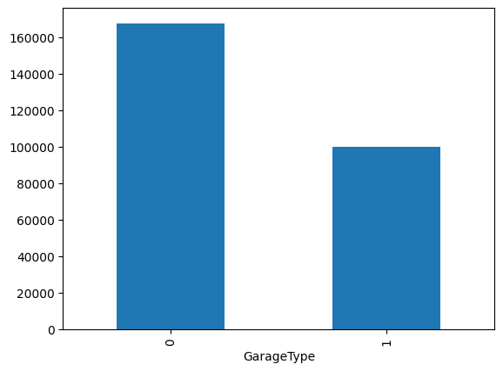



Slide 21





Slide 22
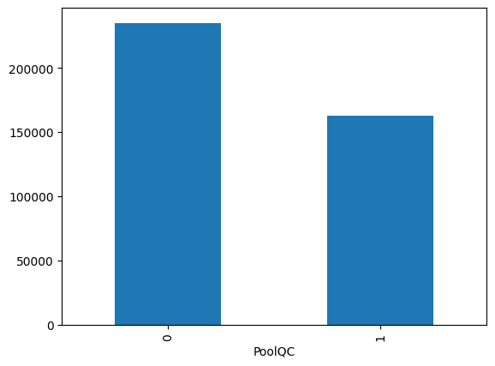
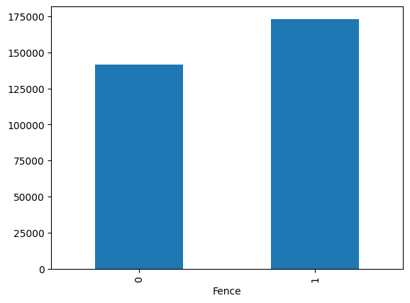
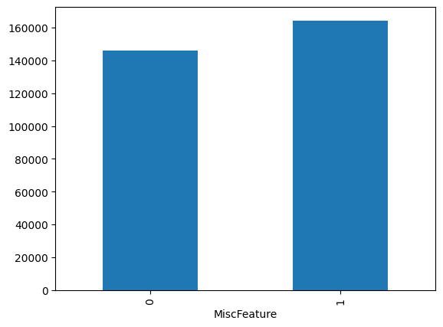


Slide 23
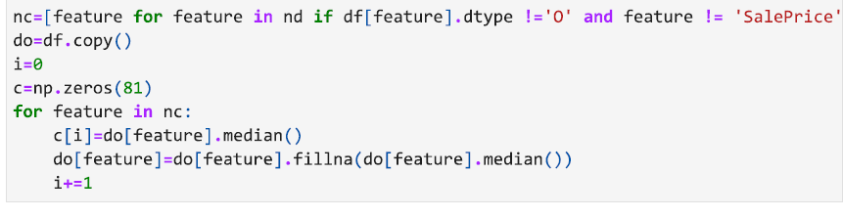
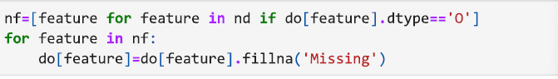
As you can see from the graphs,Sale Price depends on these null values so we simply can’t remove them.Instead we will replace them with the median values for the numerical features and the ‘missing’ category for the categorical features.

Slide 24
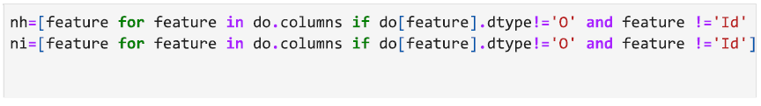
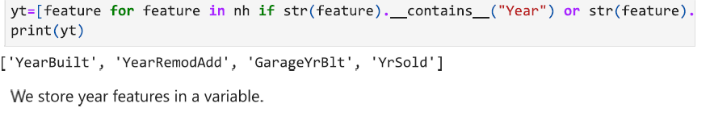
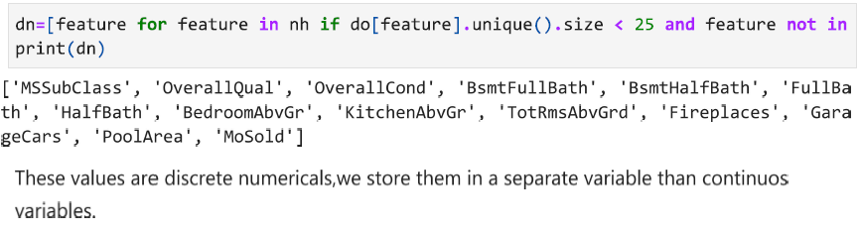
Exploratory Data Analysis

Slide 25
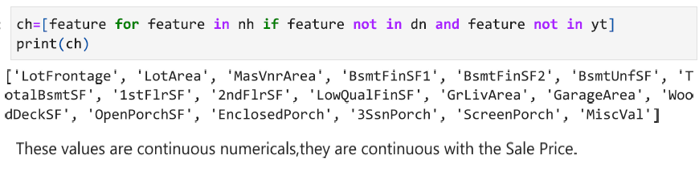
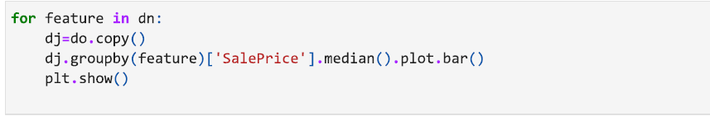
This code will plot bar graphs that shows the median value of Sale Price for each different value of the discrete numericals.

Slide 26
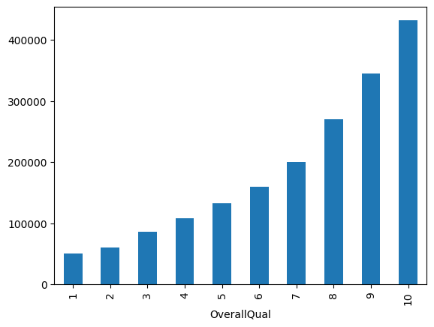
In this graph we can see that Sale Price is linearly proportional to Overall Quality.
Hence,OverallQual will be an important feature for our model.

Slide 27
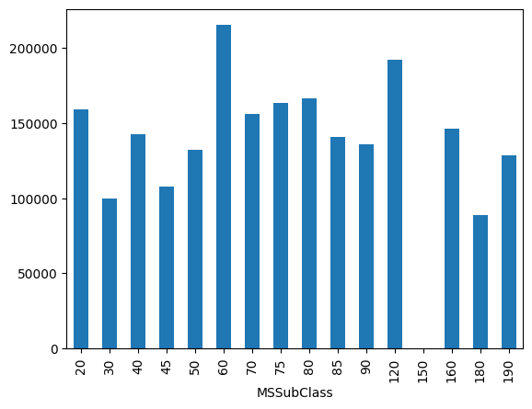
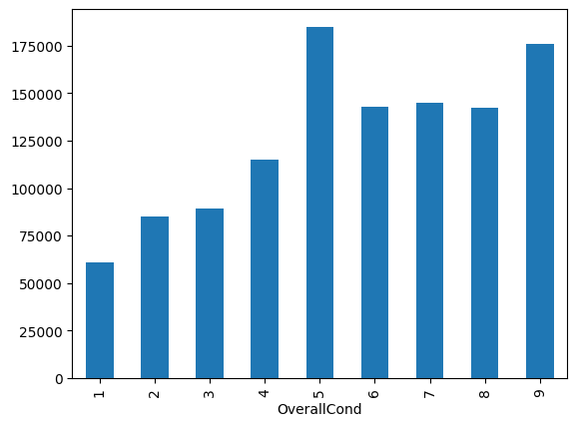
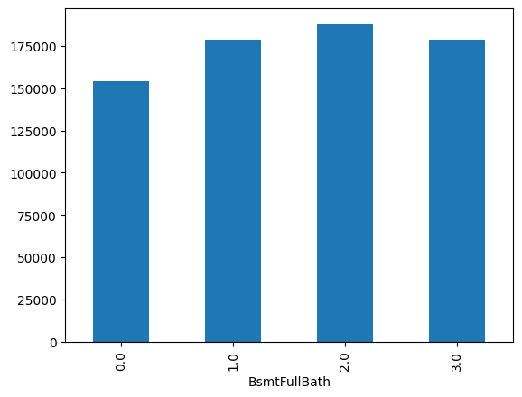
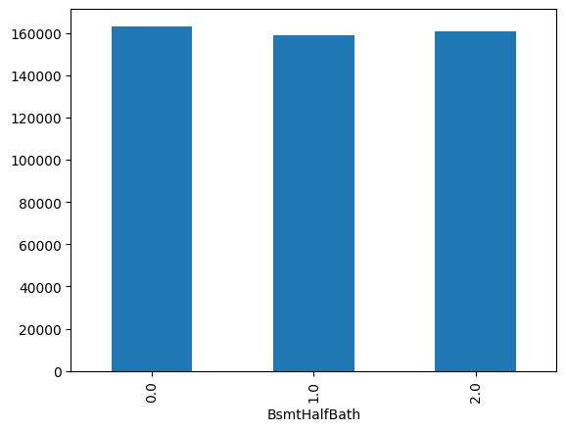

Slide 28
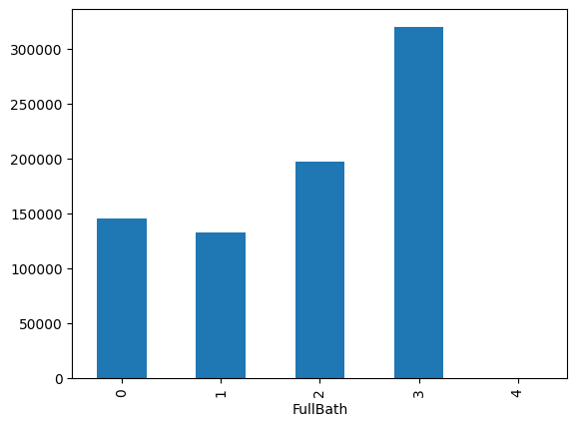
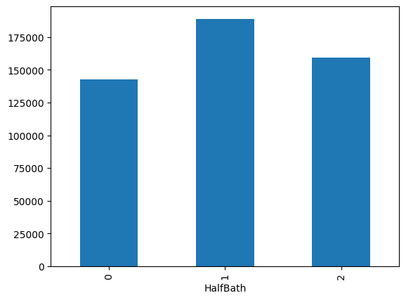
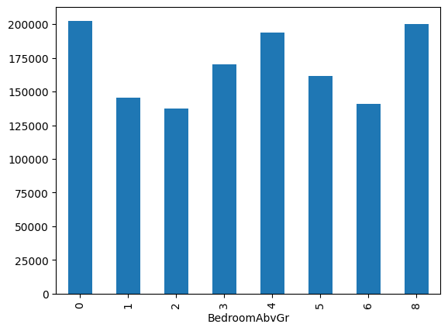
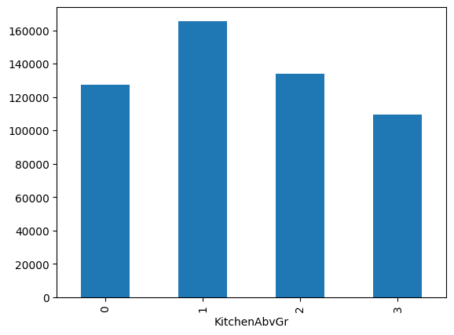

Slide 29
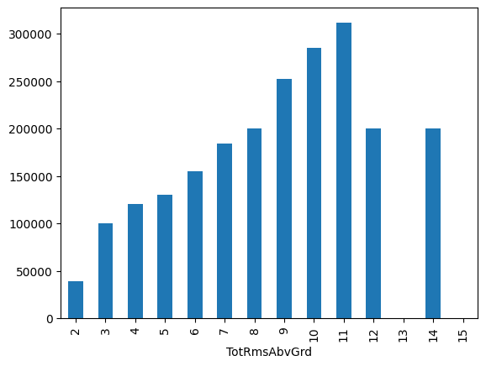
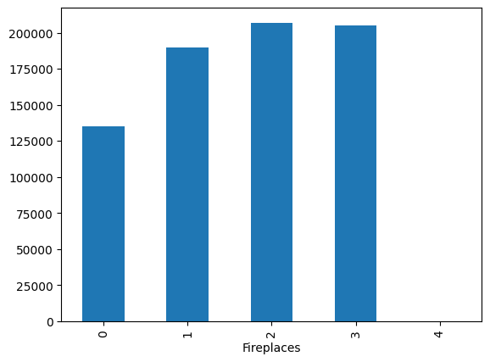
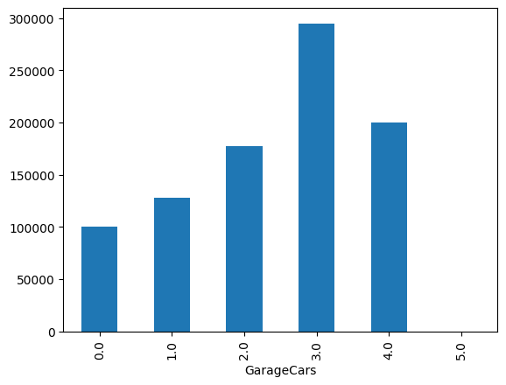
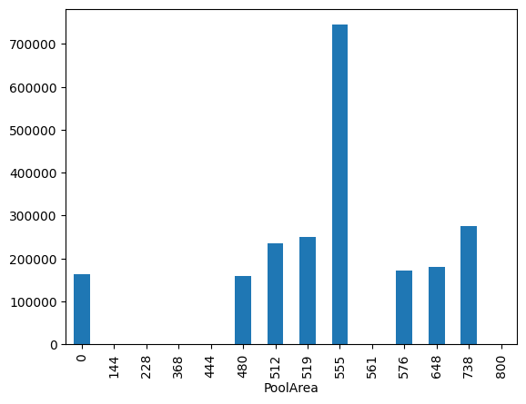

Slide 30
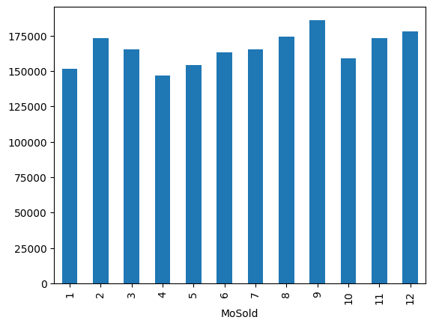
If we look at the TotRmsAbvGrd and FullBath graphs(previous slides),we can see a sort of linear relationship with Sale Price.So,we will be using TotRmsAbvGrd and FullBath in our model.

Slide 31
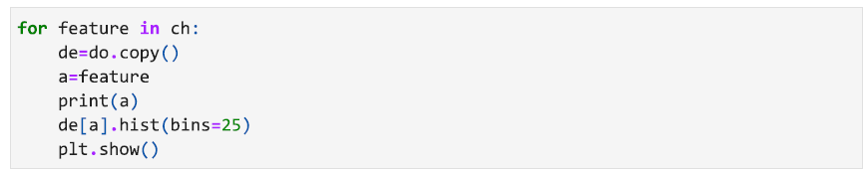
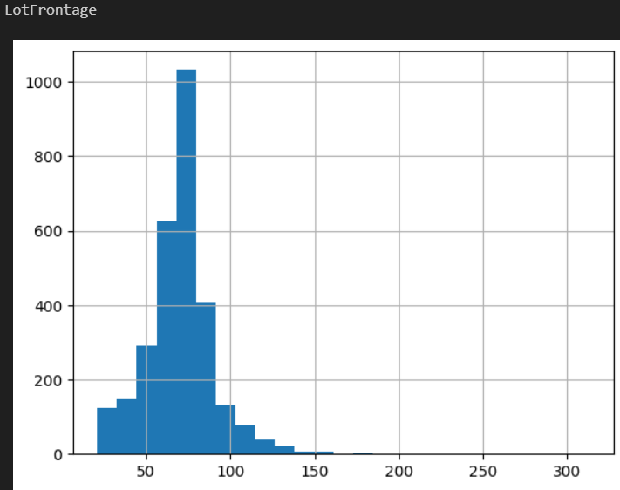
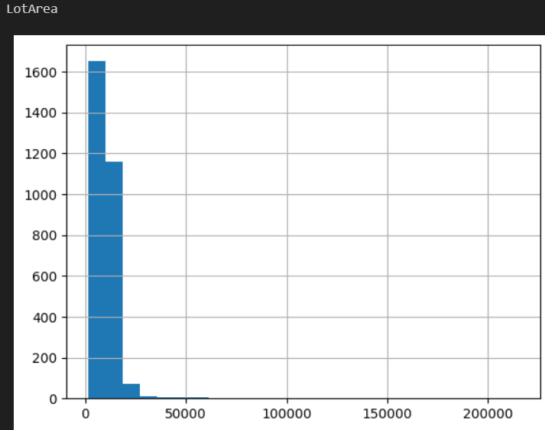
This code will create histograms of the continuous features.These histograms allow us to see the density of the values in continuous features.

Slide 32
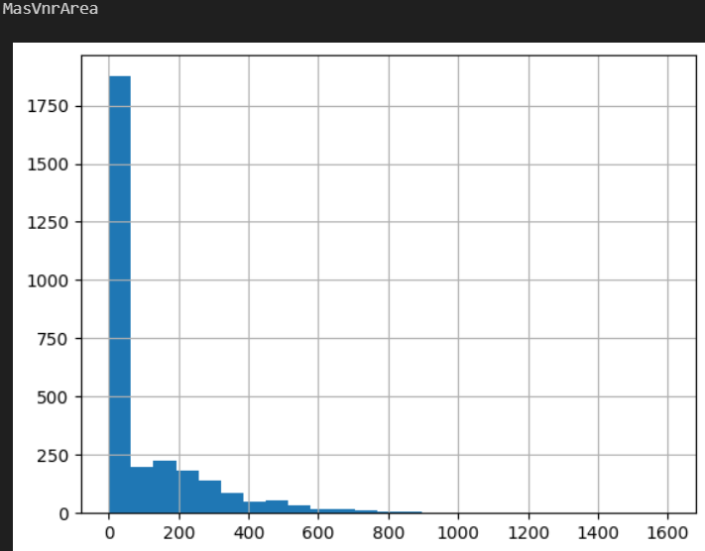
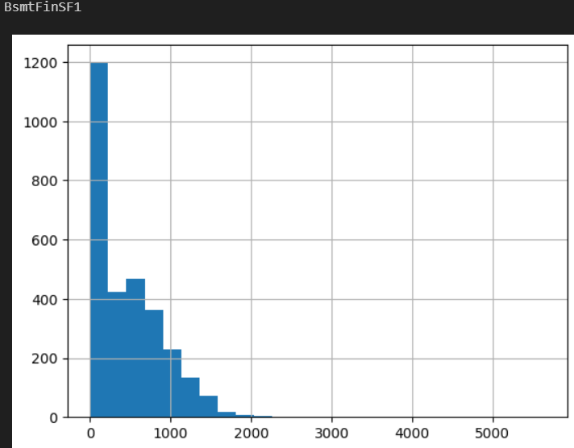
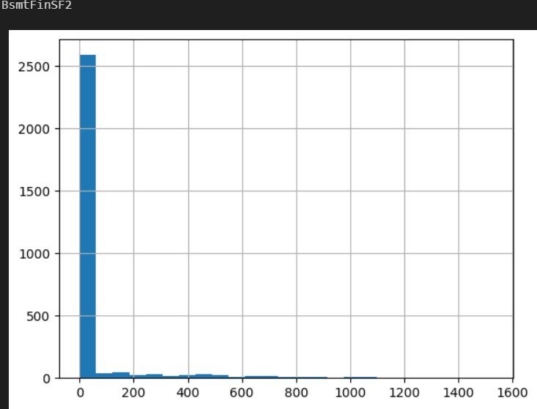
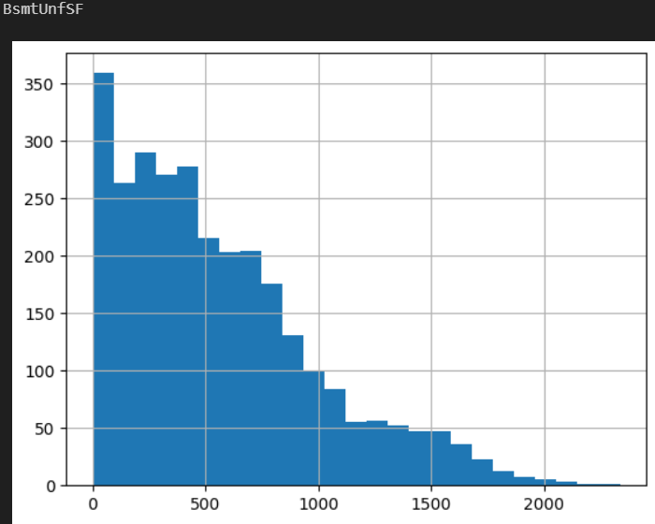

Slide 33





Slide 34





Slide 35





Slide 36

Looking at these histograms,we can clearly see most of these are left-skewed ,so to fix that we will use a logarithmic transformation.
Note that this code will ignore any continuous feature with 0 in their values as log(0) doesn’t exist.We are using a scatter plot with the log values of the data as x-axis and Sale Price corresponding to those values as y-axis.

Slide 37





Slide 38
Looking at these Scatter Plots,we can see that GrLivArea and 1stFlrSF have shapes that indicate a linear relationship with Sale Price.So we will be using them as features in our model.
However we won’t be using LotFrontage and LotArea due to them having values in straight vertical and horizontal lines in the Scatter Plot.
These Lines will make the model accustomed to the lines and decreases it’s performance.

Slide 39



This code will plot a graph with the years on x-axis and the medain of Sale Price corresponding to the Year on y-axis.

Slide 40



These year features are useful,but we can create more useful features by subtracting from YrSold with each feature.
This code will also plot the graphs of the new features.

Slide 41



These graphs show the Median of Sale Price corresponding to the age of house(YrSold-YearBuilt),time that has passed since the last remodeling(YrSold-YearRemodAdd) and the age of garage(YrSold-GarageYrBlt).

Slide 42



We add the new features to the dataset.
This code will plot a bar graph which shows the median of sale price corresponding to each unique category in the categorical features.

Slide 43





Slide 44





Slide 45





Slide 46





Slide 47





Slide 48





Slide 49





Slide 50





Slide 51





Slide 52





Slide 53



ExterQual,BsmtQual,GarageQual and KitchenQual are the categorical features we will be using since they have a sort of linear relation with Sale Price with their categorical values.For example,All the Ex value of the Quality features(with exception of GarageQual) have the highest Sale Price median.

Slide 54

This code will display the correlations between the data.I will abstract most of them and only show Sale Price’s Correlation with every other data.We will then choose the data which has a good correlation with Sale Price so that it will improve the model performance.

Slide 55


With this table,We will be able to choose approriate features for our model.We will choose features which have good correlation with Sale Price.
OverallQual,GrLivArea,1stFlrSF,YearBuilt,YearRemodAdd,MasVnrArea,TotalBsmtSF,FullBath,TotRmsAbvGrd,GarageCars,GarageArea,DrOfHouse,DrOfRemod and DrOfGar all have above or around 50 correlation with Sale Price so we will using these as our features.
So,In Summary,We will be using OverallQual,GrLivArea,1stFlrSF,YearBuilt,YearRemodAdd,MasVnrArea,TotalBsmtSF,FullBath,TotRmsAbvGrd,GarageCars,GarageArea,DrOfHouse,DrOfRemod,DrOfGar,ExterQual,BsmtQual,KitchenQual,GarageQual,2ndFlrSF,PoolQC,SaleCondition as our features for training the model.
This shows us the correlation between Sale Price and every other data.

Slide 56

Scaling Features

Slide 57
We use a column transformer to transform a specific type of feature with a different scaler.We use StandardScaler on Numerical features.OrdinalEncoder on ExterQual,GarageQual,BsmtQual,KitchenQual due to the way the categorical values are connected to each other and we use OnehotEncoder on PoolQC and SaleCondition.
We split the dataset into train set and test set,then we split the train set again to create a new test set for testing as the original test set’s Sale Price values are null so we will use our model to predict the original test’s SalePrice values.

Slide 58
Training the Model
We are using two models,SVR(Support Vector Regressor) and Random Forest Regressor(RFG).
SVR is a type of Support Vector Machine that assigns vectors to features and tries to find the hyperplane in a high-dimensional space that maximally separates output values.
Random Forest Regressor is an ensemble learning method that combines the predictions from multiple decision trees to produce a more accurate and stable prediction.It works by creating multiple of decision trees each trained on a random subset of the data.After the trees are trained each tree makes a prediction and the final prediction is the average of all the individual tree predictions.
We will first find the best parameters for each model using GridSearchCV.

Slide 59


SVR Model Tuning
RFG Model Tuning

Slide 60
The above slide give us the best parameters as well as the score of all combinations of the parameters given.
The first line in the output gives us the best parameters for the model.
The lines below the first line gives us scores of the parameters given.We can see that the score for the best parameters is the lowest.
So,the lower the score,the better is the performance of the model.

Slide 61

The first 3 outputs are from SVR while the last 3 are from Random Forest Regressors.
We use the K-cross fold validation process to check if the model is overfitting.
In this process,we divide the training set into 10 subsets and train the model 10 times,picking a different fold for validation every time and training on the other 9 folds.

Slide 62
The first line in the output is the error generated by SVR on the training set.It is around 21090.
The values after the first line in the output is the score of the SVR on each fold.The lower the score,the better the model is.
The 2 values after the scores of each fold is the mean of the scores and the standard deviation of the score.The mean score for the SVR is 21749.157.
The value after the 2 values is the error generated by Random Forest Regressor on the training set.It is around 7000 which would be a decent but the model is overfitting.
The scores on K-cross fold validation prove the point.The mean of the score is around 19000,way higher than the error generated on the training set.So Random Forest Regressor is overfitting but the mean score of the RFG is still lower than SVR so,perhaps the better model to use is Random Forest Regressor.

Slide 63

The error generated by Random Forest Regressor on the test set is around 19000.
The error generated by SVR is around 21600.

Slide 64

These are the predictions made by the models(Top is Random Forest Regressor and bottom is SVR.
We have sucessfully created a model that can predict house prices.

Slide 65
Summary of Tools & Technologies
Languages: Python
Libraries: NumPy, pandas, scikit-learn, Matplotlib, Seaborn
Techniques: Regression, Feature Scaling, EDA, Regularization

Slide 66
Conclusion
I have now learned about Linear Regression,Logistic Regression,EDA,Classification
and trained a model to predict house prices,derive numbers from images and predict loan status.
In essence, a house price prediction model is a sophisticated tool that leverages data to help people navigate the complexities of the real estate market.

Slide 67
Bibliography
1.https://www.geeksforgeeks.org/machine-learning/house-price-prediction-using-machine-learning-in-python/
2.https://github.com/MYoussef885/House_Price_Prediction
3.https://www.appliedaicourse.com/blog/house-price-prediction-using-machine-learning/
4.https://ijarsct.co.in/Paper17879.pdf
5.https://blog.stackademic.com/from-data-to-dollars-predicting-house-prices-with-machine-learning-techniques-d64e9873d732
6.https://ideas.repec.org/a/vrs/remava/v33y2025i1p1-10n1001.html

